Slide 1

Clustering Algorithms as a means of identifying potential bias
Dylan Rohan
Many systems and organizations struggle to accurately assess for bias; implicit or otherwise. This project aims to use historical data and clustering models to identify patterns of bias in a way that is non-confrontational/promotes cohesion, is low cost, and is simple to analyze.
Research question:
Are clustering models able to detect patterns of potential bias?
Sub question(s):
Can this be achieved with available resources?
Is the tool accessible.
Notes:
You have provided a brief but detailed overview of your research project, addressing your project title, research problem or challenge, and question/s.

Slide 2
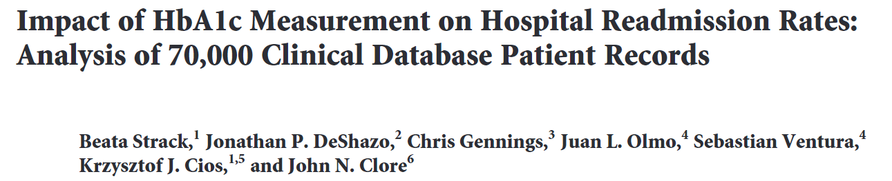



Data
Task
Data subsets (high instance, high dimensionality, and PCA components) have been compiled, cleaned, and pre-processed (normalized or one-hot encoded) and run through clustering algorithms such as K-means, DBSCAN, etc. Silhouette score metrics determine the degree of separation. And the data has been split into five folds for stability analysis.
The models are blind to identity features to prevent researcher bias. These features will be reintroduced to assess cluster population statistics later.
The aim is not to prove a bias. It is to:
To demonstrate and test this concept, a dataset was obtained from the UC Irvine Machine Learning Repository. This dataset was first collected by Strack et al. to assess diabetic patient readmissions (2014). The dataset is appropriately licensed for broader use.
It had the original shape of (101766, 48) and contains data collected from 1999 -2008 from 130 hospitals across America.
Link: https://archive.ics.uci.edu/dataset/296/diabetes+130-us+hospitals+for+years+1999-2008
Identify groups based on patterns from historical data
Assess those groups to determine if there is an association with an identity feature.
If there is an association, promote a conversation to determine the reason.
Notes:
You have provided a brief, clear and comprehensive overview of the task and data you have identified, developed, and are working with in your project.

Slide 3
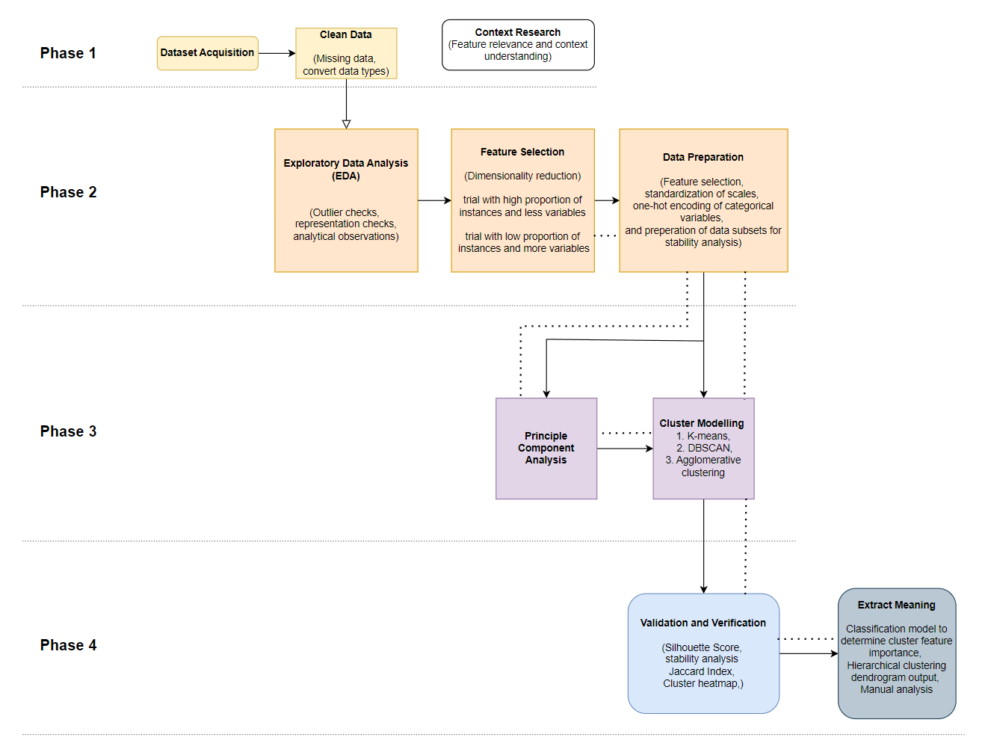


Methods
Notes:
You have provided a clear and comprehensive description of the methods you have used in your data collection, processing, and analysis. Processes and choices (including specific techniques, solutions, methods, components, processes and/or tools) are explained and justified. The methods selected and used are appropriate for the research project, problem, and data science conventions. Relevant examples, visuals, and supporting evidence are used as appropriate. The connections between components of research design are clearly articulated.

Slide 4
Phase 3:
Initial trials indicate that density-based algorithms are better suited
SHAP values were suggested to provide some explanation as to what was most relevant during the prediction phase, but trials indicate these are inappropriate or require an additional model to accurately predict clusters based on the available data.
Instead, manual analysis will tease out the meaning behind clusters.

Slide 5
Phase 4:
Silhouette scores and cross validation are being used to assess stability and validity. Currently the best output is with DBSCAN producing silhouette scores of ~ 0.9, though this is results in thousands of clusters.
Processing power and time is influencing progress, however HDBSAN may offer a useful alternative.

Slide 6
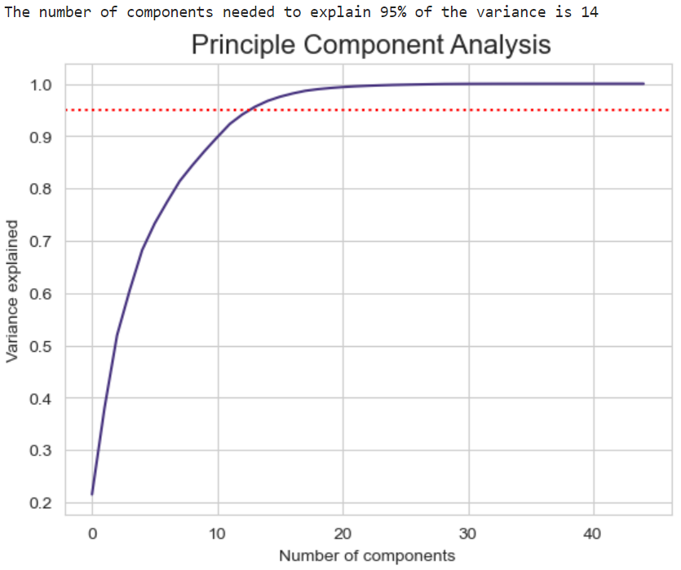
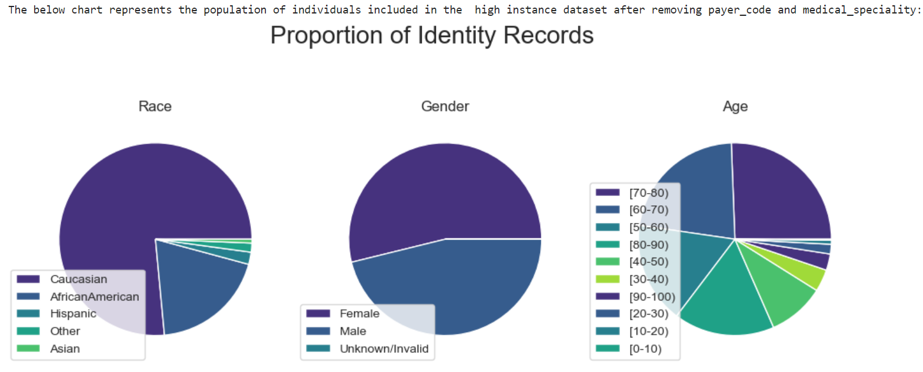
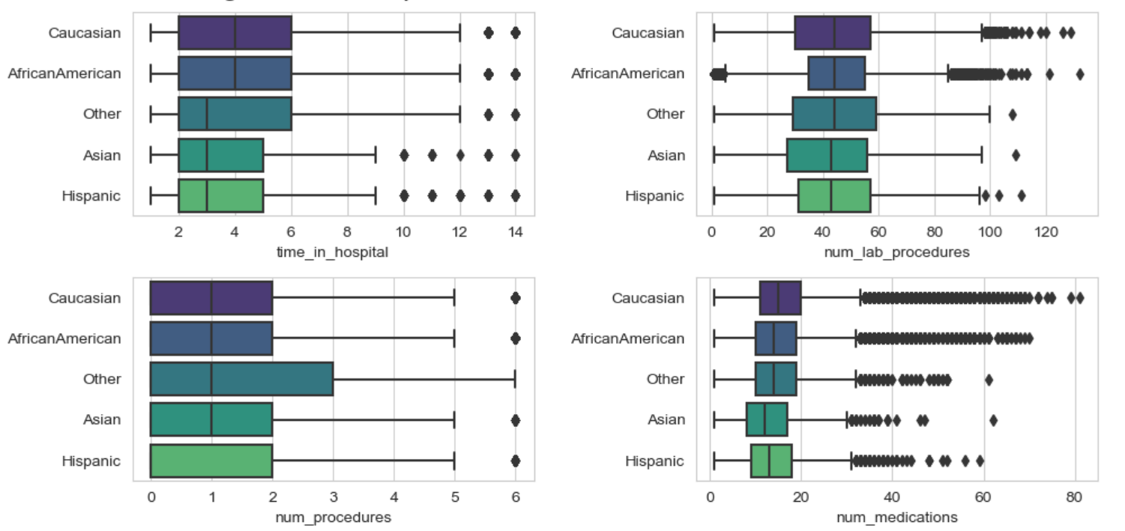
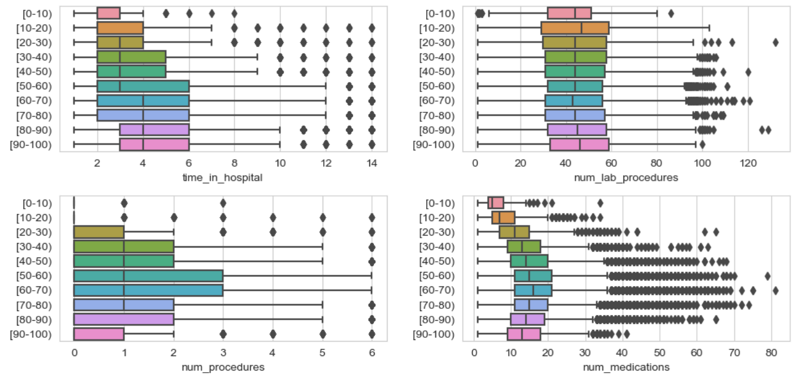
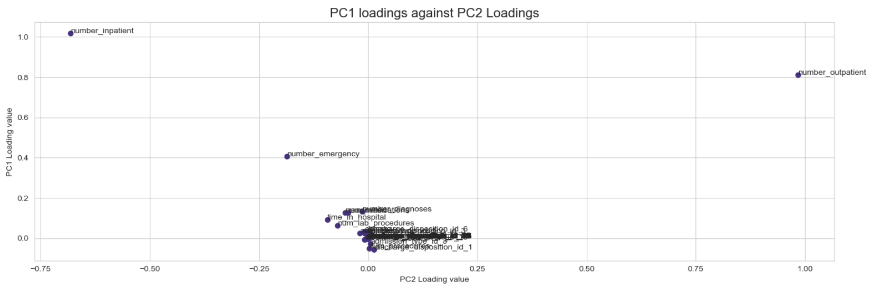
Results – EDA & PCA
Notes:
You have provided a clear, comprehensive, concise overview of your results. Results are placed in context and the significance of the results discussed. Relevant examples, visuals, and supporting evidence are used as appropriate

Slide 7
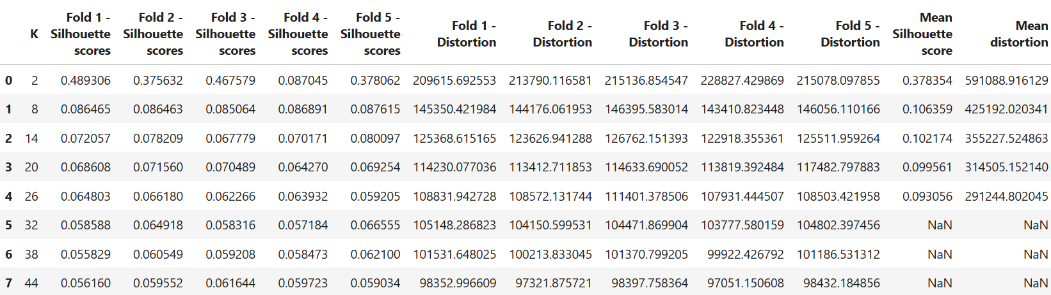
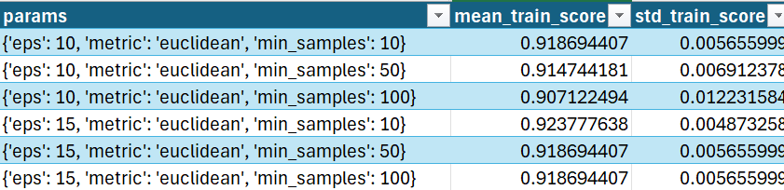
Results – Example Output
Table 1: Example output from K-means model. Note the low mean silhouette score beyond k = 2.
Table 2: Example output from DBSCAN model. Comparatively better silhouette scores, but results in hundreds of clusters.

Slide 8
Results – Kmeans and DBSCAN
The difficulty with K-means is that it requires some expectation of the number of clusters. Without that, you need to iterate through various k values and each run takes a considerable amount of time.
K-means may struggle to establish boundaries given the clusters are more likely than not to be asymmetrical.
DBSCAN requires only eps and min-sample parameters, but again the iterations required are computationally expensive. It is also difficult because metrics indicate good separation, but so much of the data has been marked as noise. It is a delicate balance.

Slide 9
Next steps and solutions
Balancing complexity for resource demands
Dimensionality reduction
Reduce instances
Reduce eps, increase min_samples
Variability in the dataset results in more complex models, HDBSCAN or OPTICS are potential alternatives.
Beyond that, attempting the same method on an alternate dataset, or conceding that this is not efficient or helpful tools
Notes:
You have discussed any unsolved problems, and clearly and critically identified and explained any unfinished/remaining parts or processes required to solve the research task. The solutions and next steps you have presented are appropriate for the project and course, and accurately scoped, with a project plan included (timeline for the rest of project and any proposed solutions).

Slide 10
References
Ankerst, M, Breunig, MM, Kriegel, H-P & Sander, J 1999, 'OPTICS: ordering points to identify the clustering structure', paper presented at Proceedings of the 1999 ACM SIGMOD international conference on Management of data, Philadelphia, Pennsylvania, USA.
McInnes, L, Healy, J & Astels, S 2017, 'hdbscan: Hierarchical density based clustering', Journal of Open Source Software, vol. 2, no. 11, p. 205.
Strack, B, Deshazo, JP, Gennings, C, Olmo, JL, Ventura, S, Cios, KJ & Clore, JN 2014, 'Impact of HbA1c Measurement on Hospital Readmission Rates: Analysis of 70,000 Clinical Database Patient Records', BioMed Research International, vol. 2014, pp. 1-11.
van Giffen, B, Herhausen, D & Fahse, T 2022, 'Overcoming the pitfalls and perils of algorithms: A classification of machine learning biases and mitigation methods', Journal of Business Research, vol. 144, 2022/05/01/, pp. 93-106.

